Slide 1
3 Axis Pin Development Update
Week #7

Slide 2
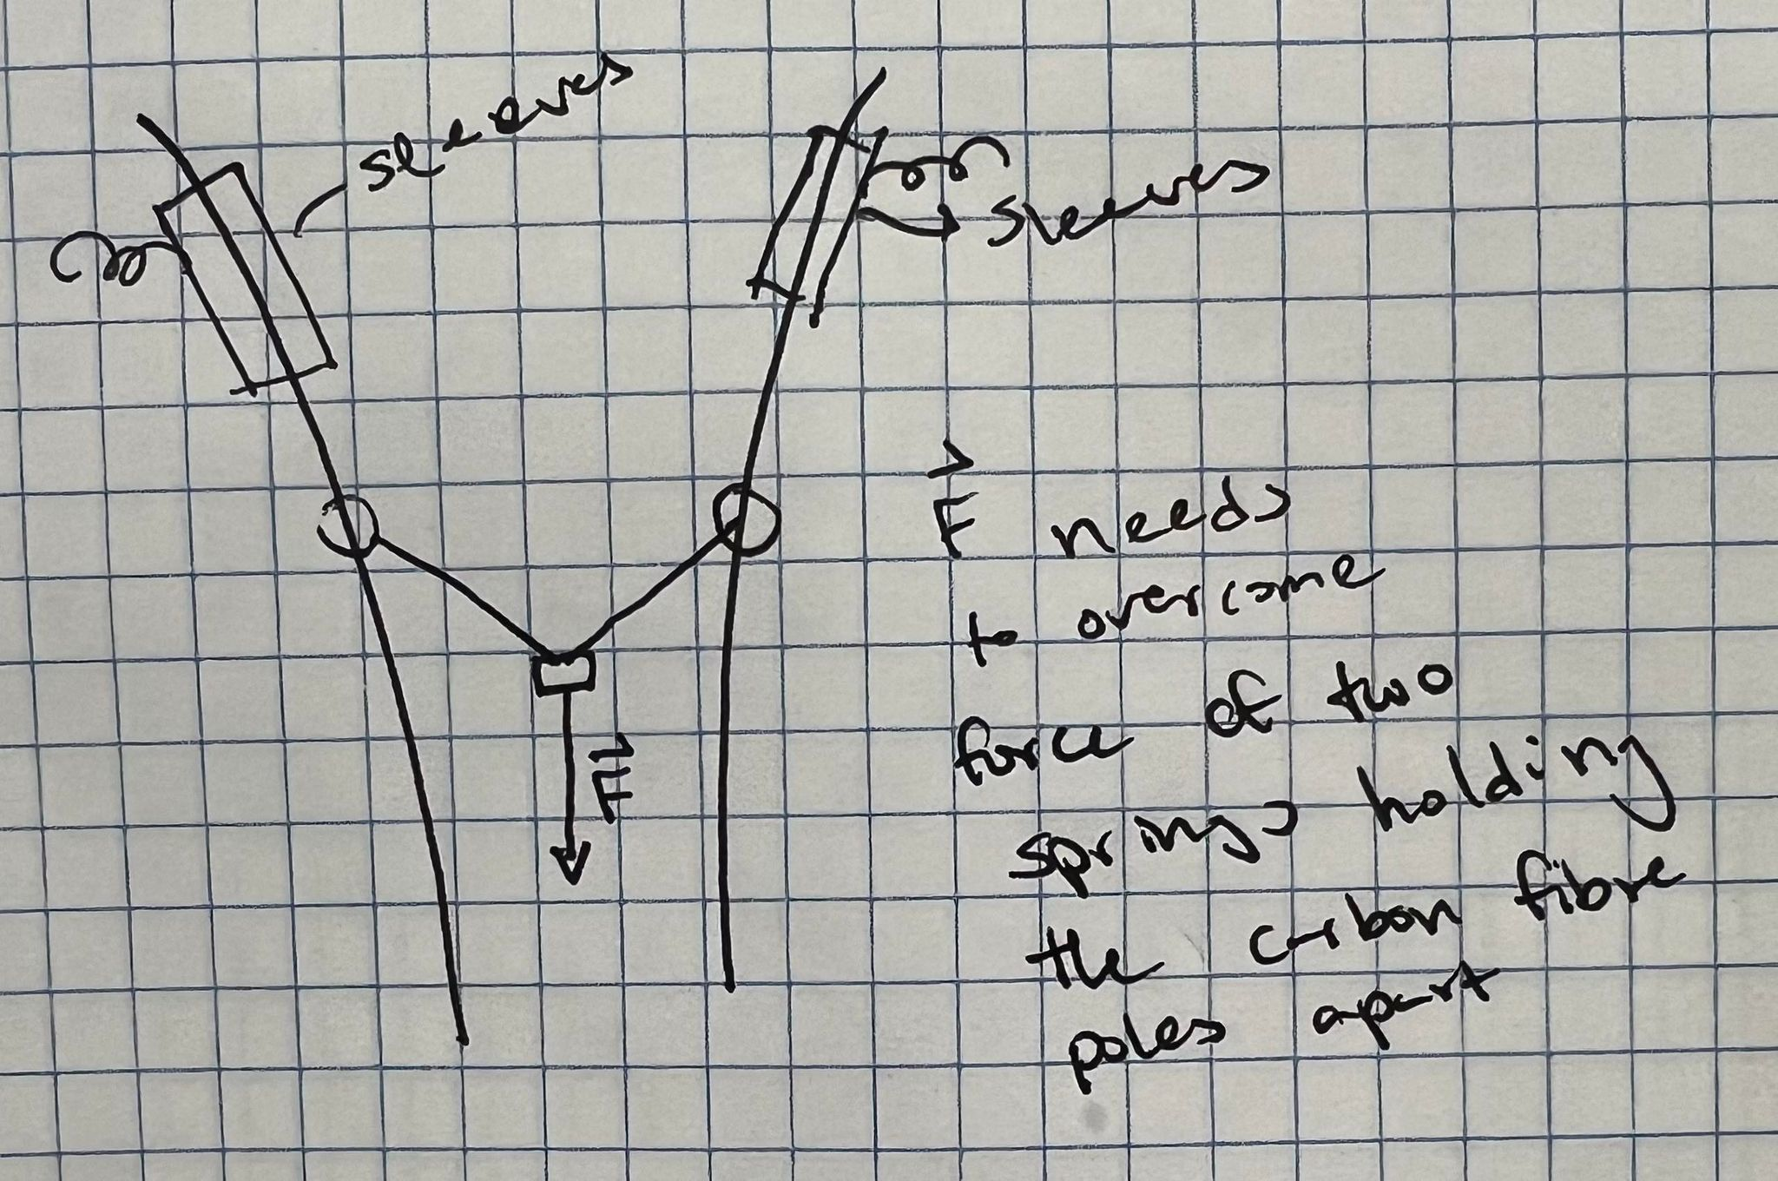
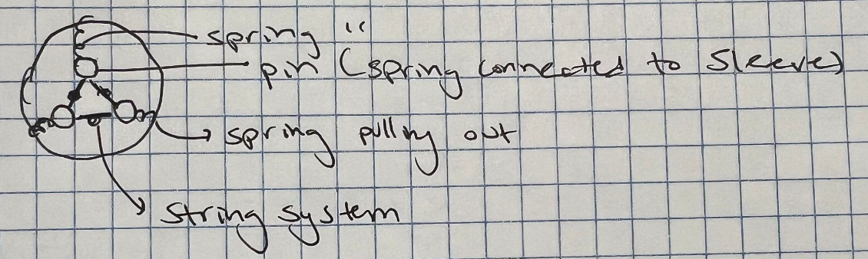
Idea

Slide 3
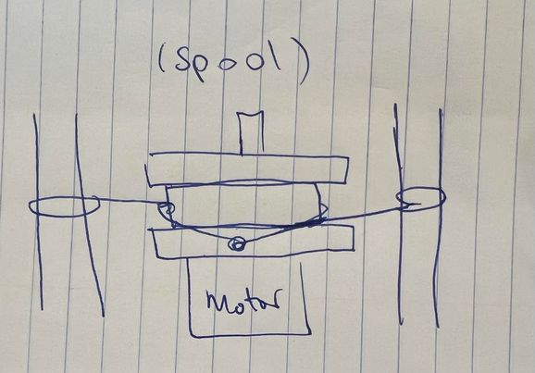
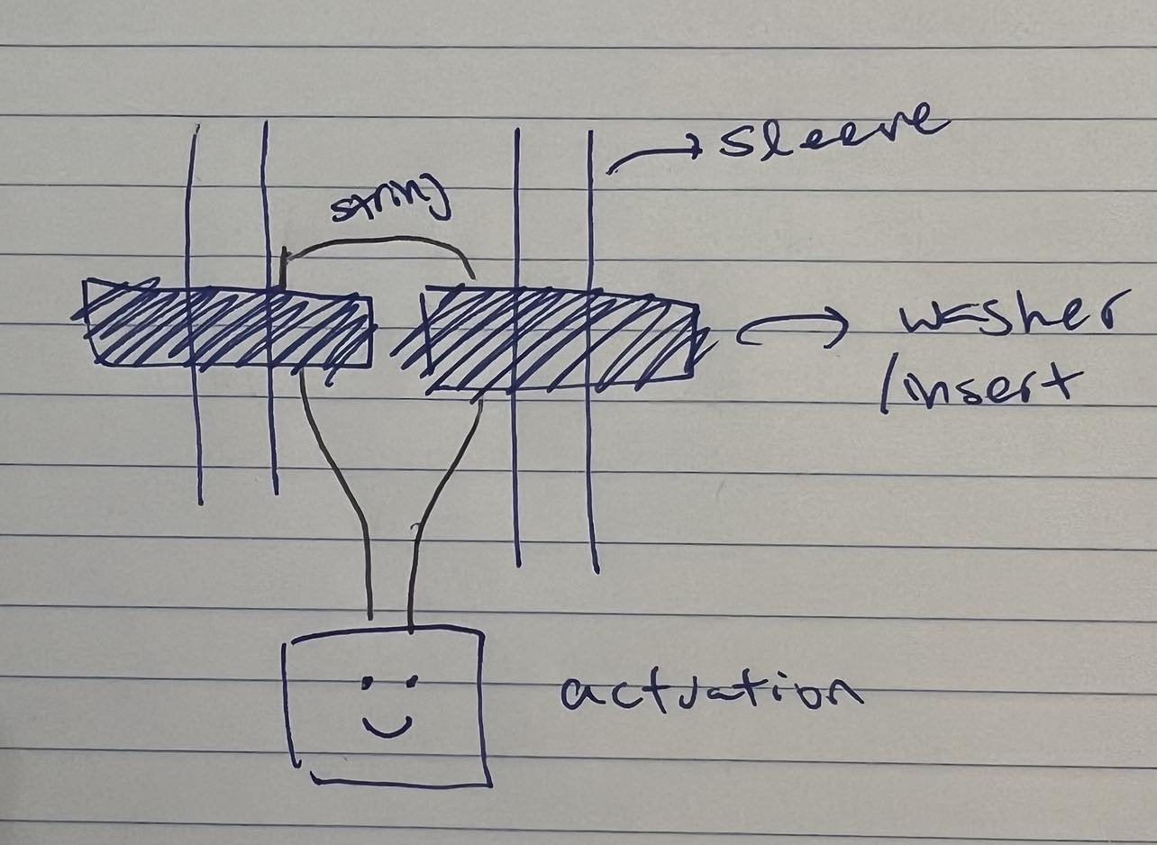
More Ideas…

Slide 4
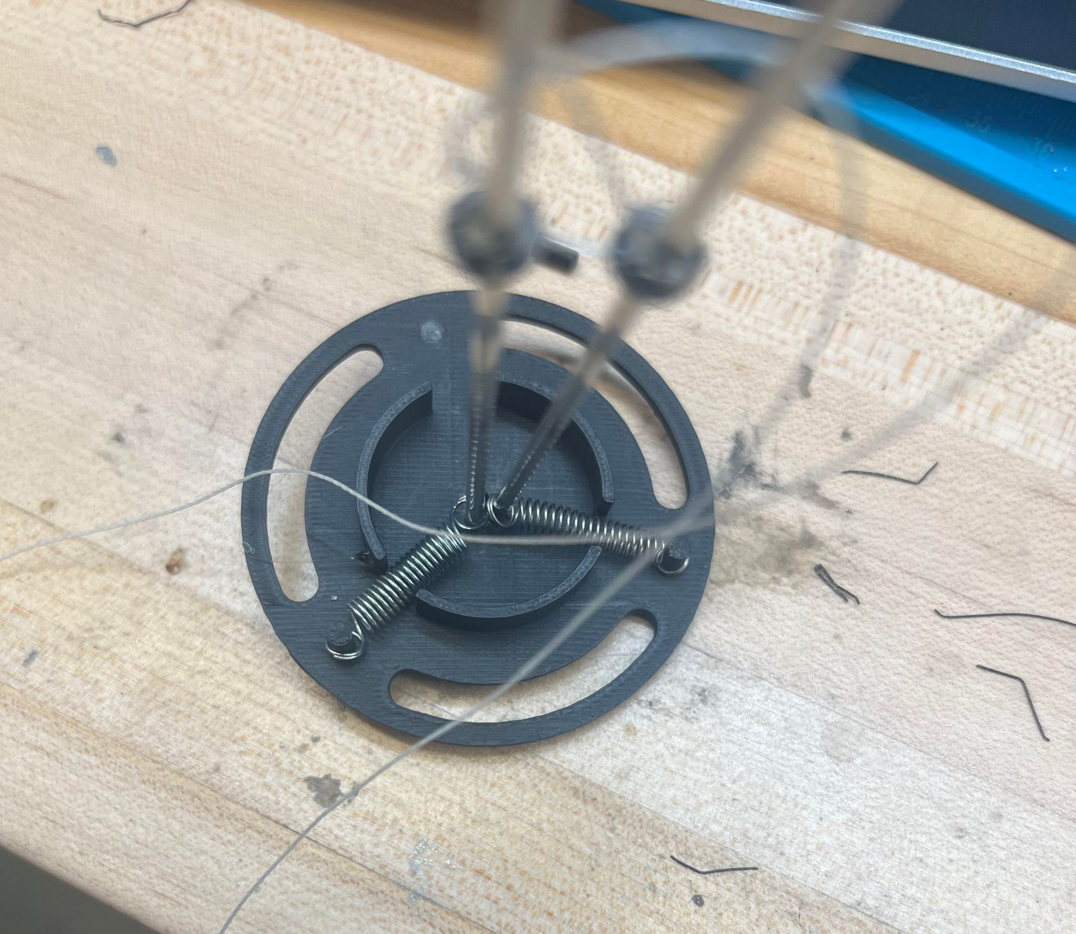
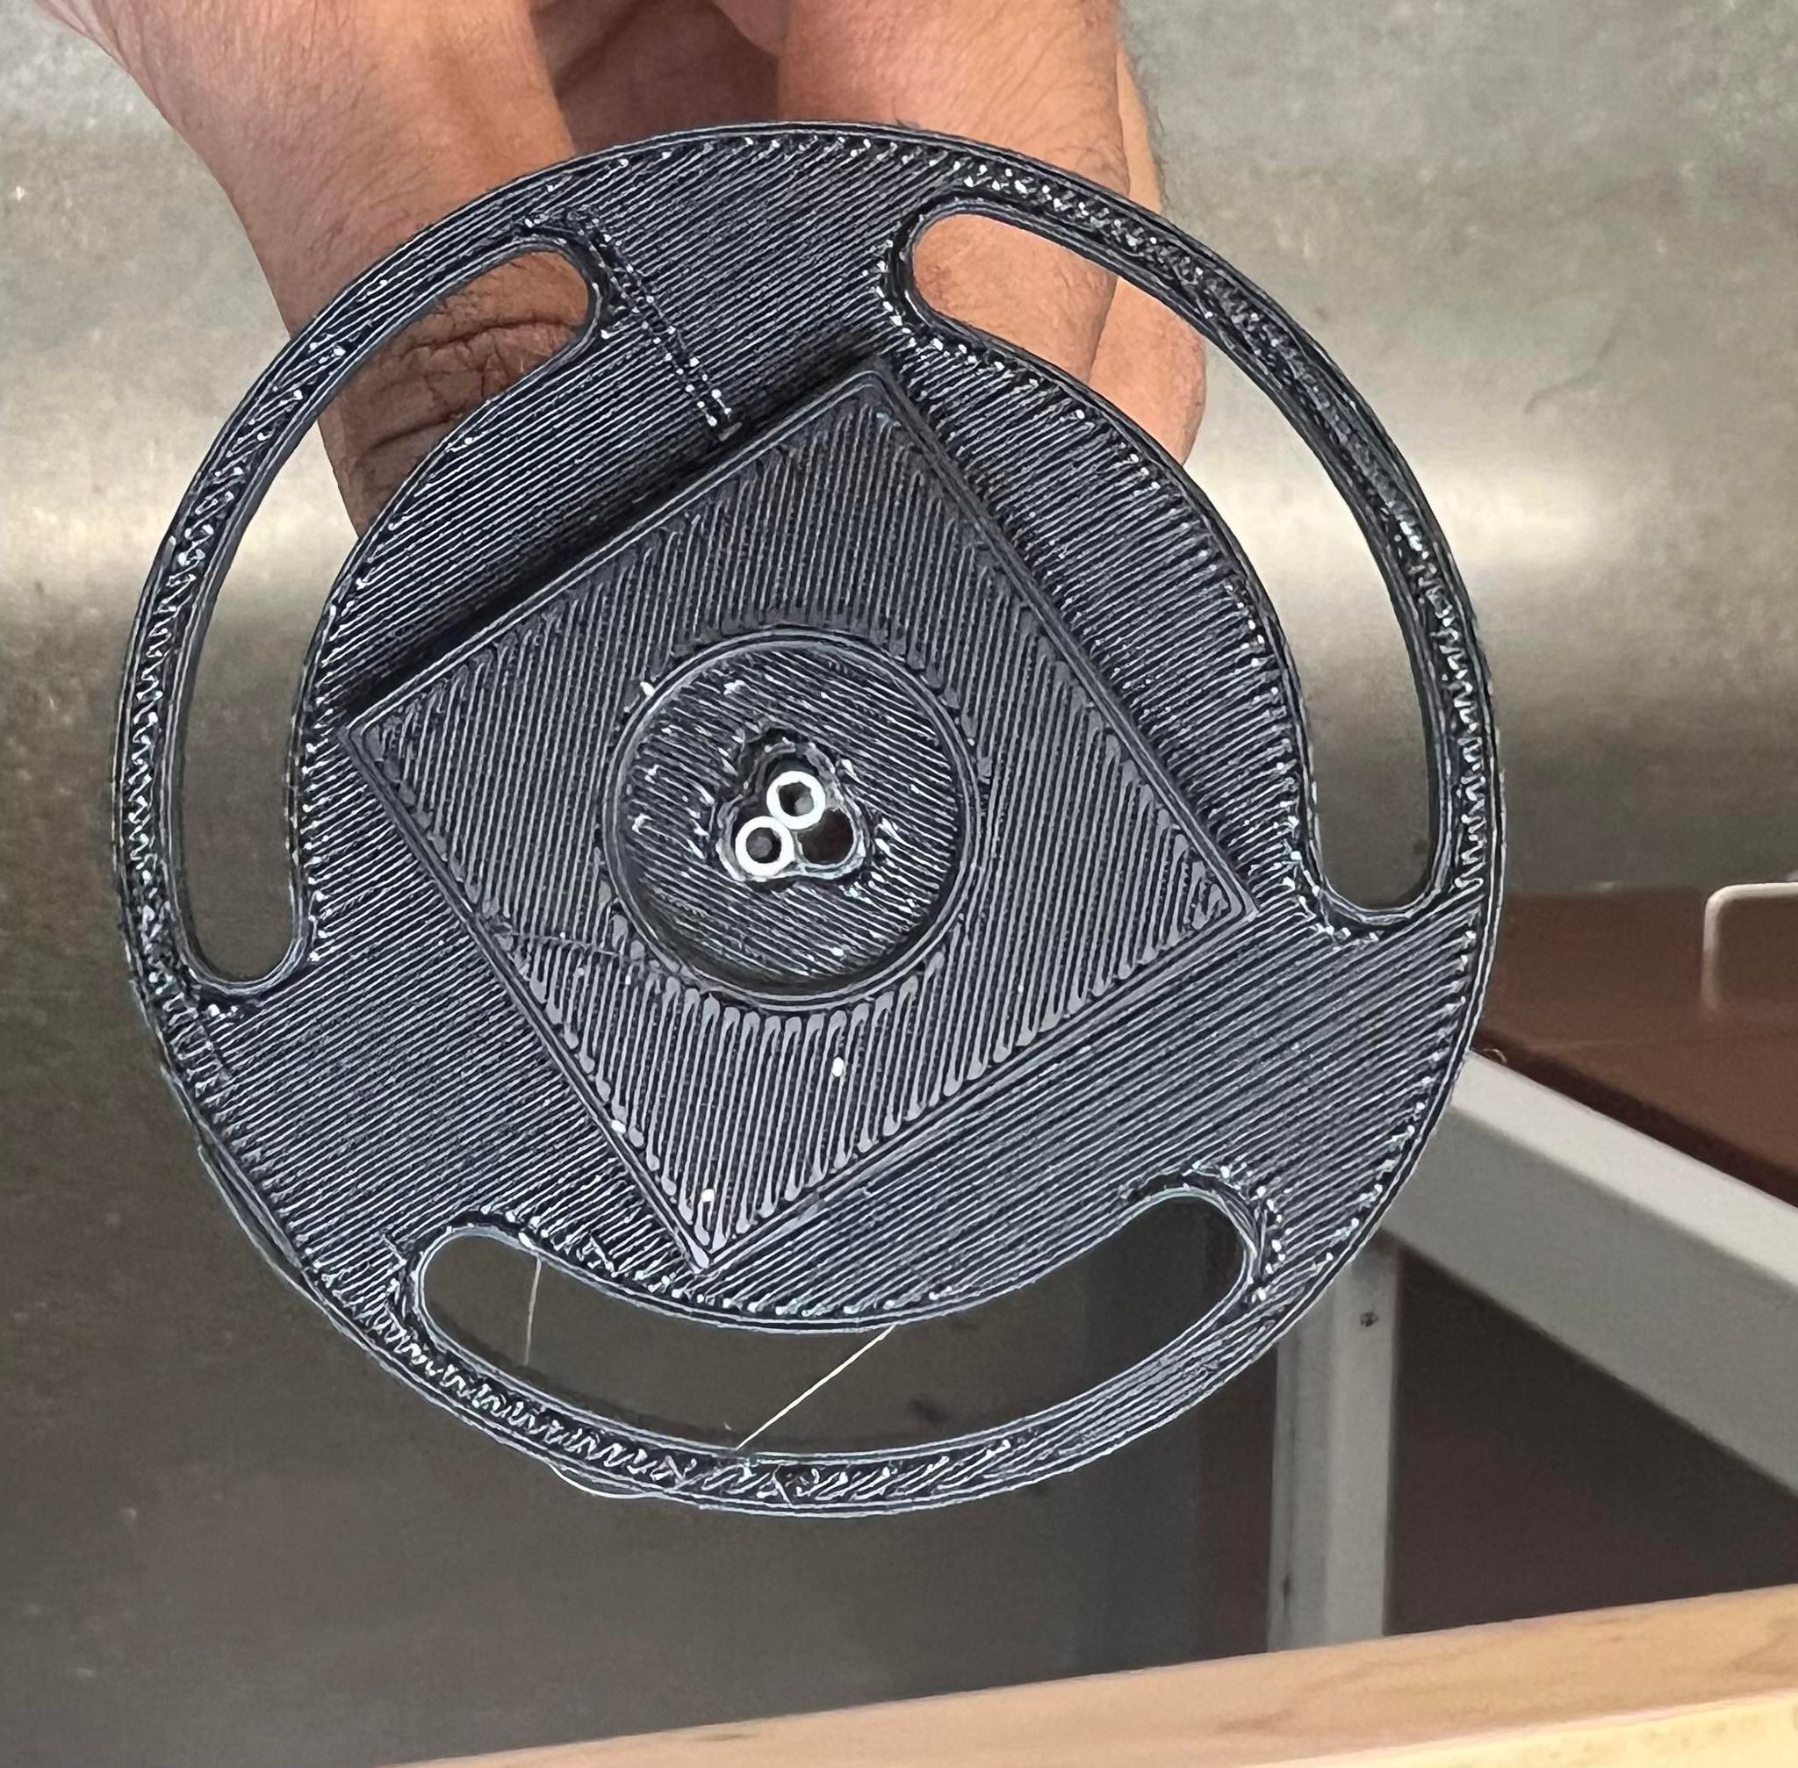
Prototype #3

Slide 5
Previous Problems
Washer Method
String needs to be able to freely move
Smaller Springs
Spacing between sleeves
Need to be bigger

Slide 6
Idea
Because horizontal motion is connected to string system pulling up and down:
Actuate fishing line with voice coils
Translating vertical motion into horizontal
:)
Sylvia Recs :)

